Slide 1



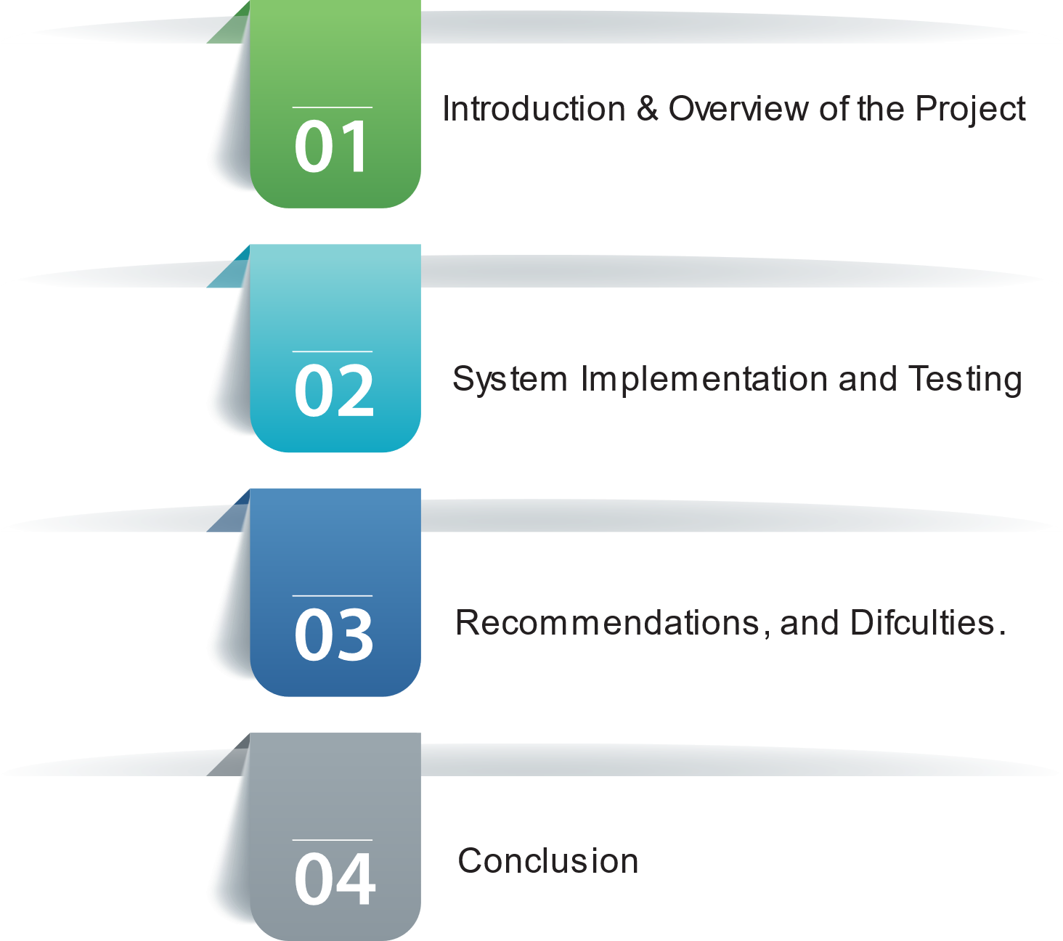

Saleh Mohammed Alanazi Mousa Mohammed Bariqi Sultan Yahya Alawaji Esam Muftin Alotaibi
A Prediction Model-Based Application to forecast the Attainment of the Programs' Learning Outcomes (PLOs) at the University of Tabuk (UoT)
Supervisor: Dr. Awad M. Awadelkarim

Slide 2

Outlines:

Slide 3



[10:08 PM]
[10:08 PM]
[10:08 PM]
[10:08 PM]
[10:08 PM]
Introduction & Overview of the Project
The system aims to identify students at risk of failure and improve learning outcomes achievement.
Academic institutions face significant challenges in enhancing postgraduate learning outcomes.
Learning outcomes encompass knowledge and skills expected to be acquired by students.
The improvement initiative aims to meet market demands and prepare graduates more effectively.
Failure to align with the job market adequately may result in a shortage of qualified workforce, negatively impacting the national economy.
1

Slide 4
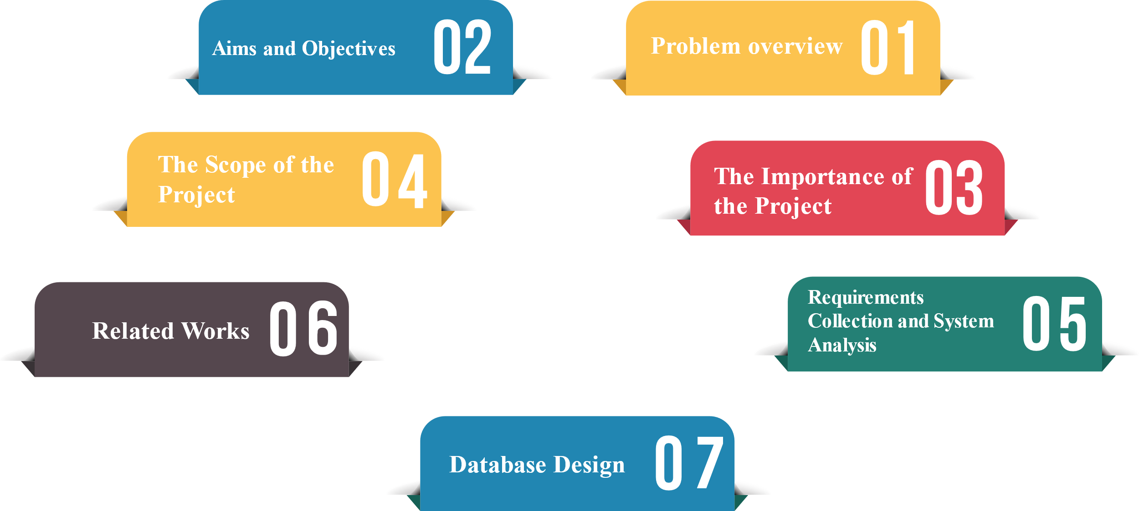
Introduction & Overview of the Project
2

Slide 5

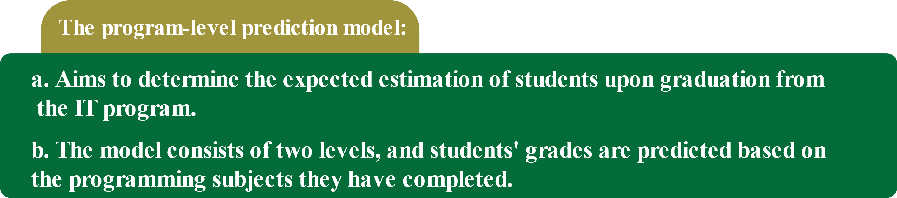





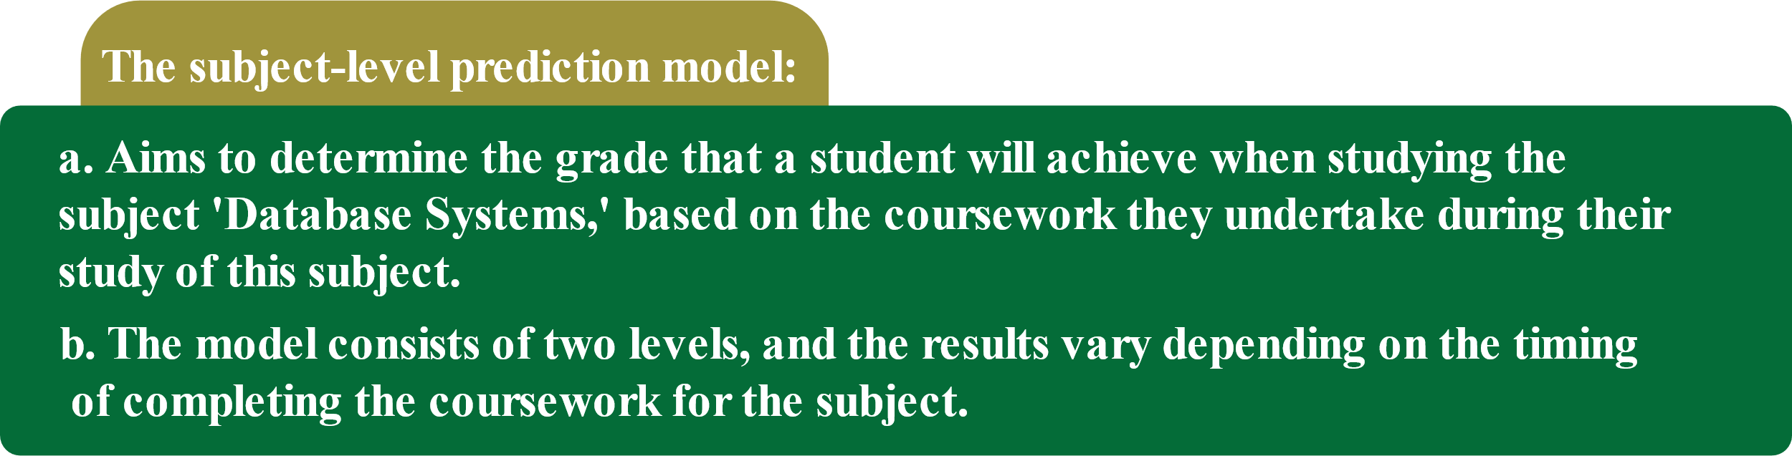

System Implementation and Testing
3

Slide 6
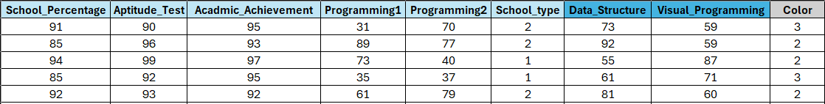
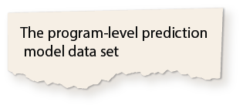
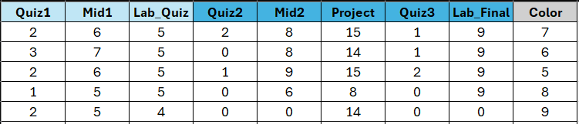
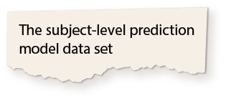
System Implementation and Testing
4

Slide 7
System Implementation and Testing
Login Interface
4

Slide 8
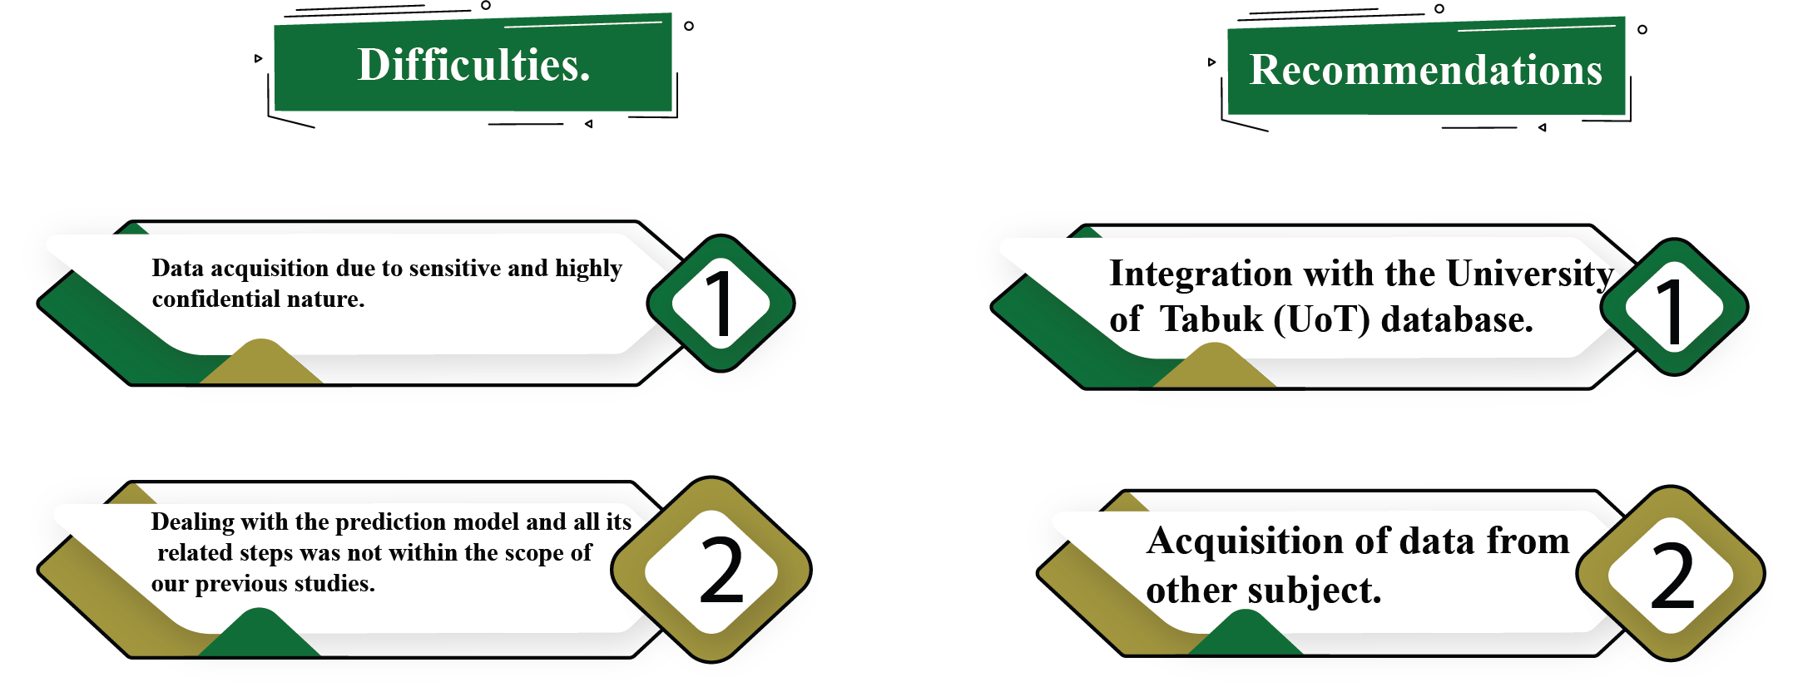

Recommendations and Difficulties.
4

Slide 9

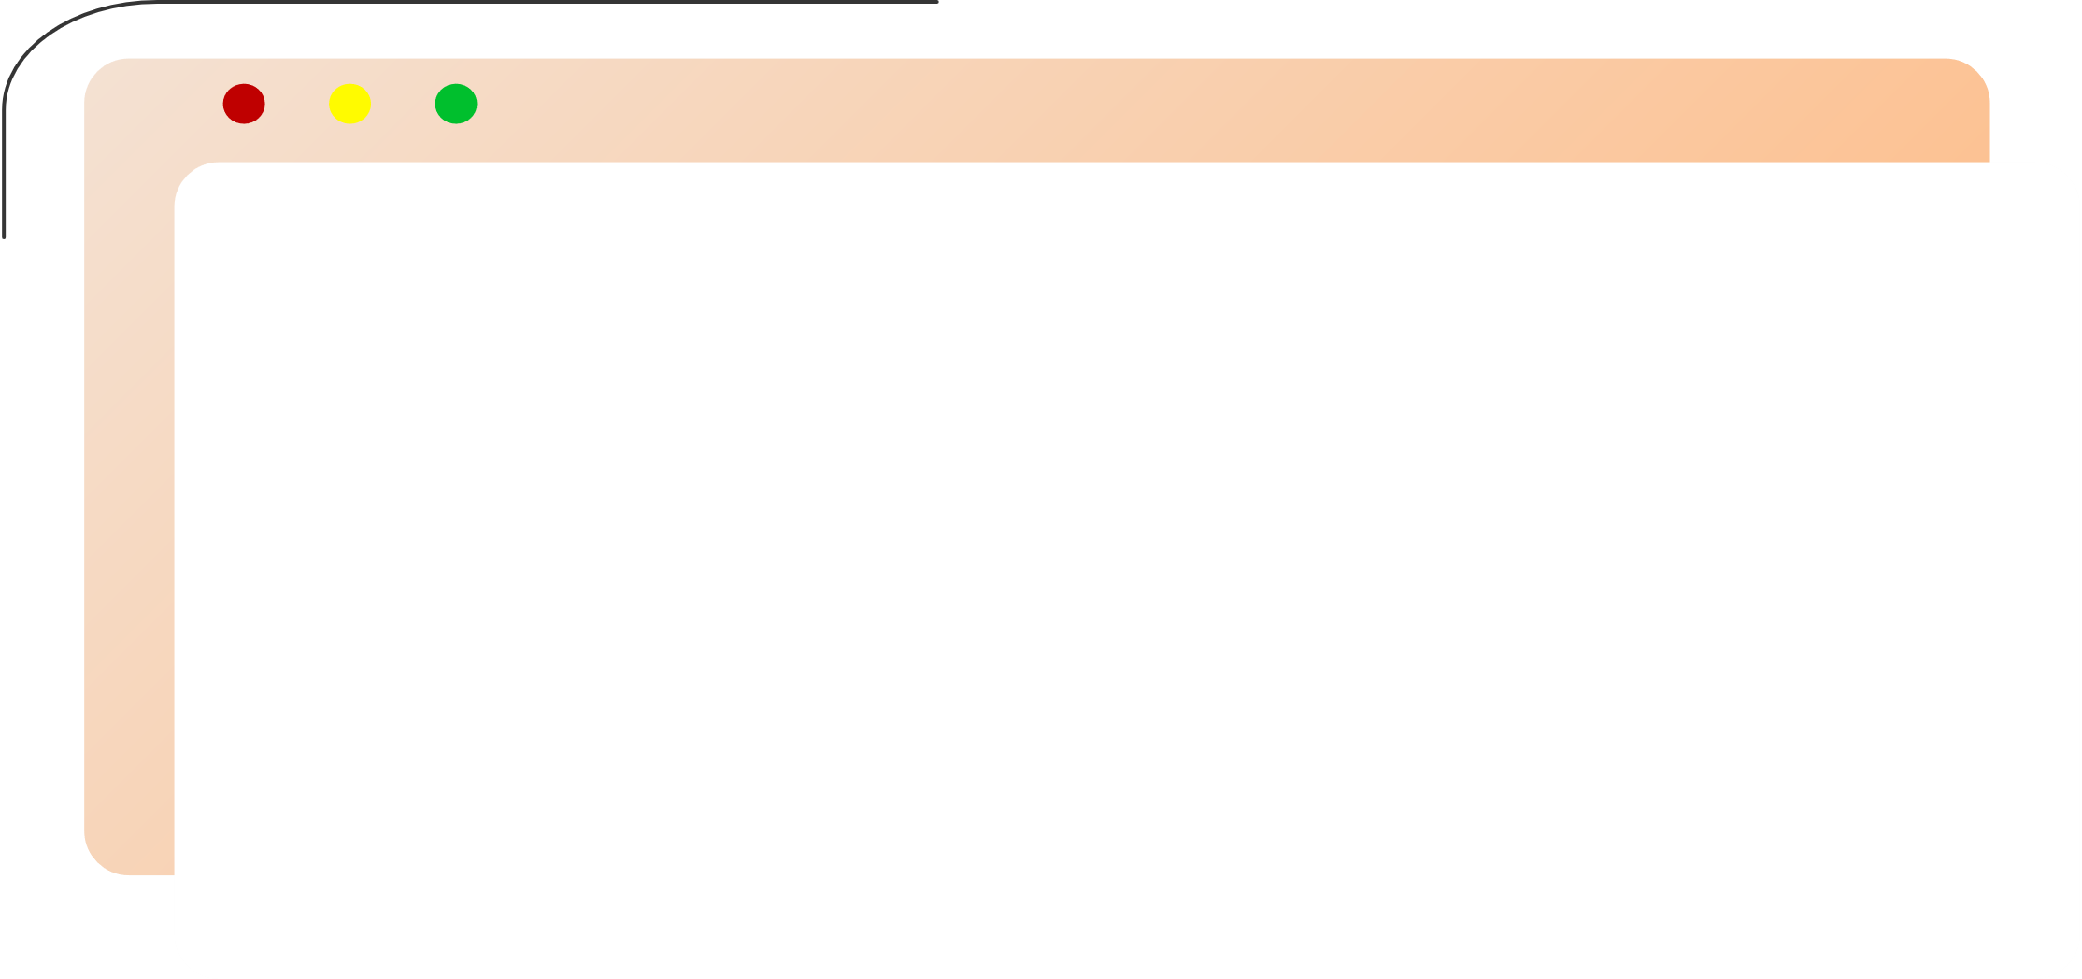
Conclusion
In this Project Report, Two chapters are covered:
Firstly, The System Implementation and testing chapter, which includes system building sections such as how the prediction model was created, trained, and tested in detail, and user interfaces of the system.
Whilst the final chapter presents, Recommendations, Difficulties, and Conclusion
21

Slide 10


